Slide 1





Slide 2

PROJECT PRESENTATION

Slide 3
PRESENTED BY:
Madiha Abbasi - 47383
Rida Fatima - 48403
Ayesha Butt - 48288
Hanzla Alvi - 47583

Slide 4

SIOMS

Slide 5


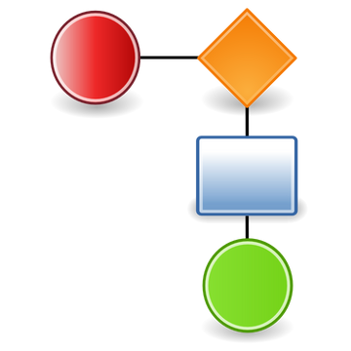
SIOMS
The Smart Inventory and Order Management System (SIOMS) efficiently manages inventory, orders, and reporting processes.
It tracks stock levels, notifies suppliers for restocking, and updates inventory in real time.
Customers can search for products, place orders, and track their order statuses.
Admins oversee the system, manage users, and generate reports on inventory and sales trends.
Suppliers handle product listings, restock items, and maintain accurate inventory records.

Slide 6
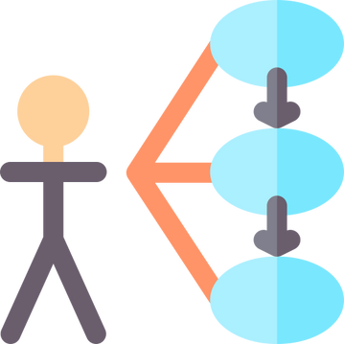
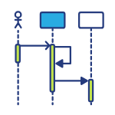
Diagrams
Domain Model
Use Case Diagram
Sequence Diagram
Activity Diagram
Class Diagram
State Diagram
MVC & GRASP
https://drive.google.com/file/d/1oGuoalnd_uAe1a6h9XNFadI1dcN_qawc/view?usp=sharing

Slide 7
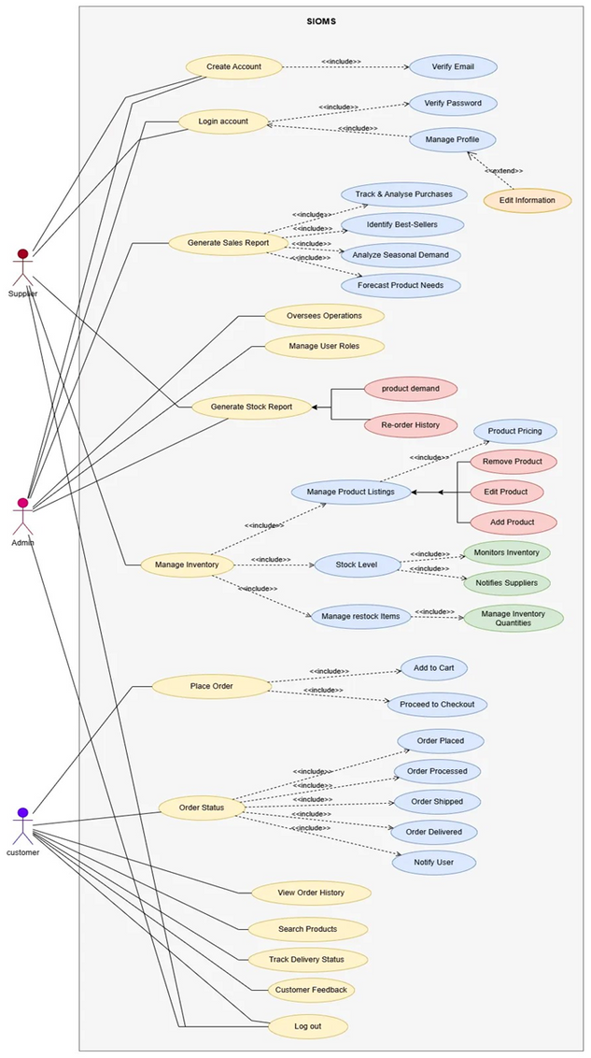
Use Case Diagram

Slide 8
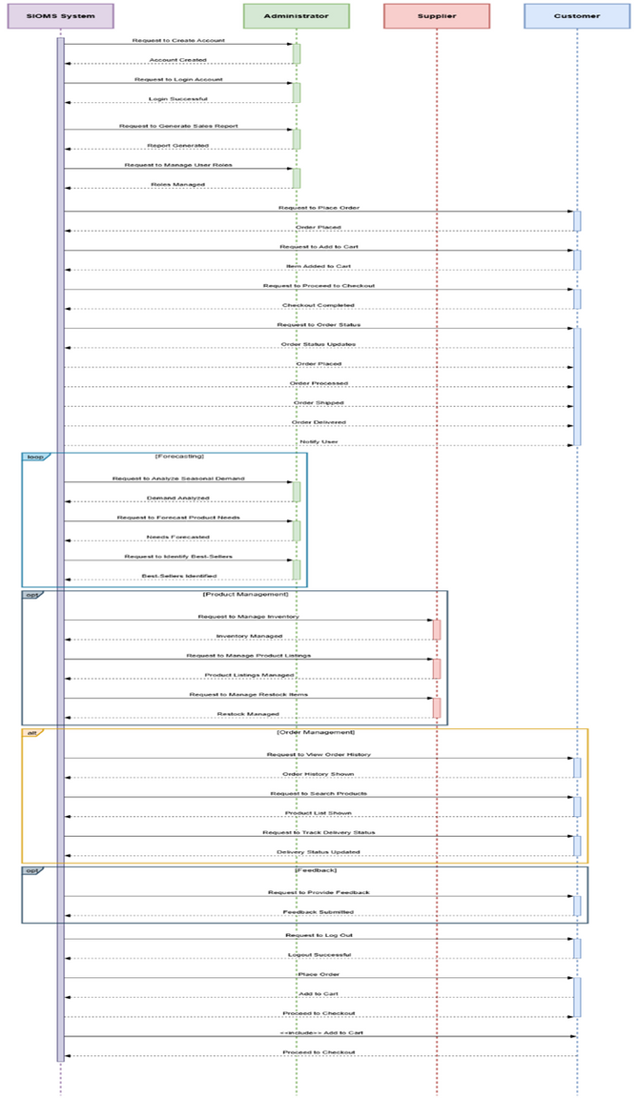
Sequence Diagram

Slide 9
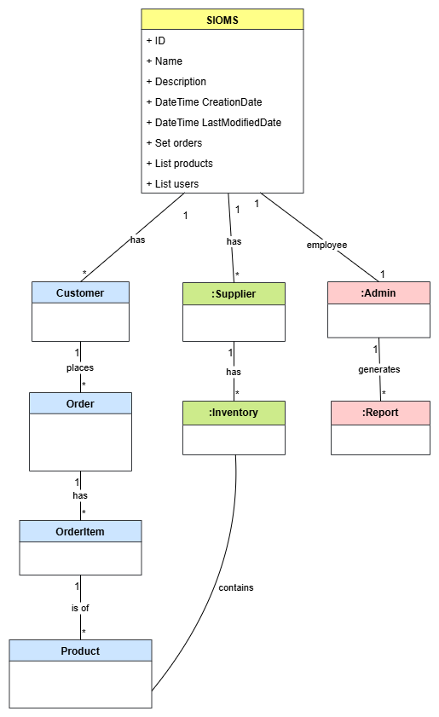
Domain Model

Slide 10
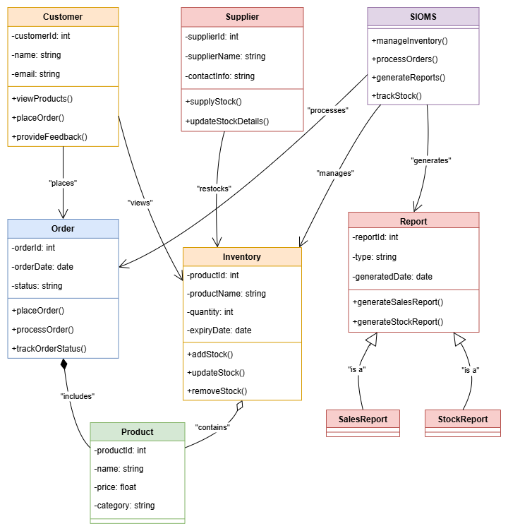
Class Diagram

Slide 11
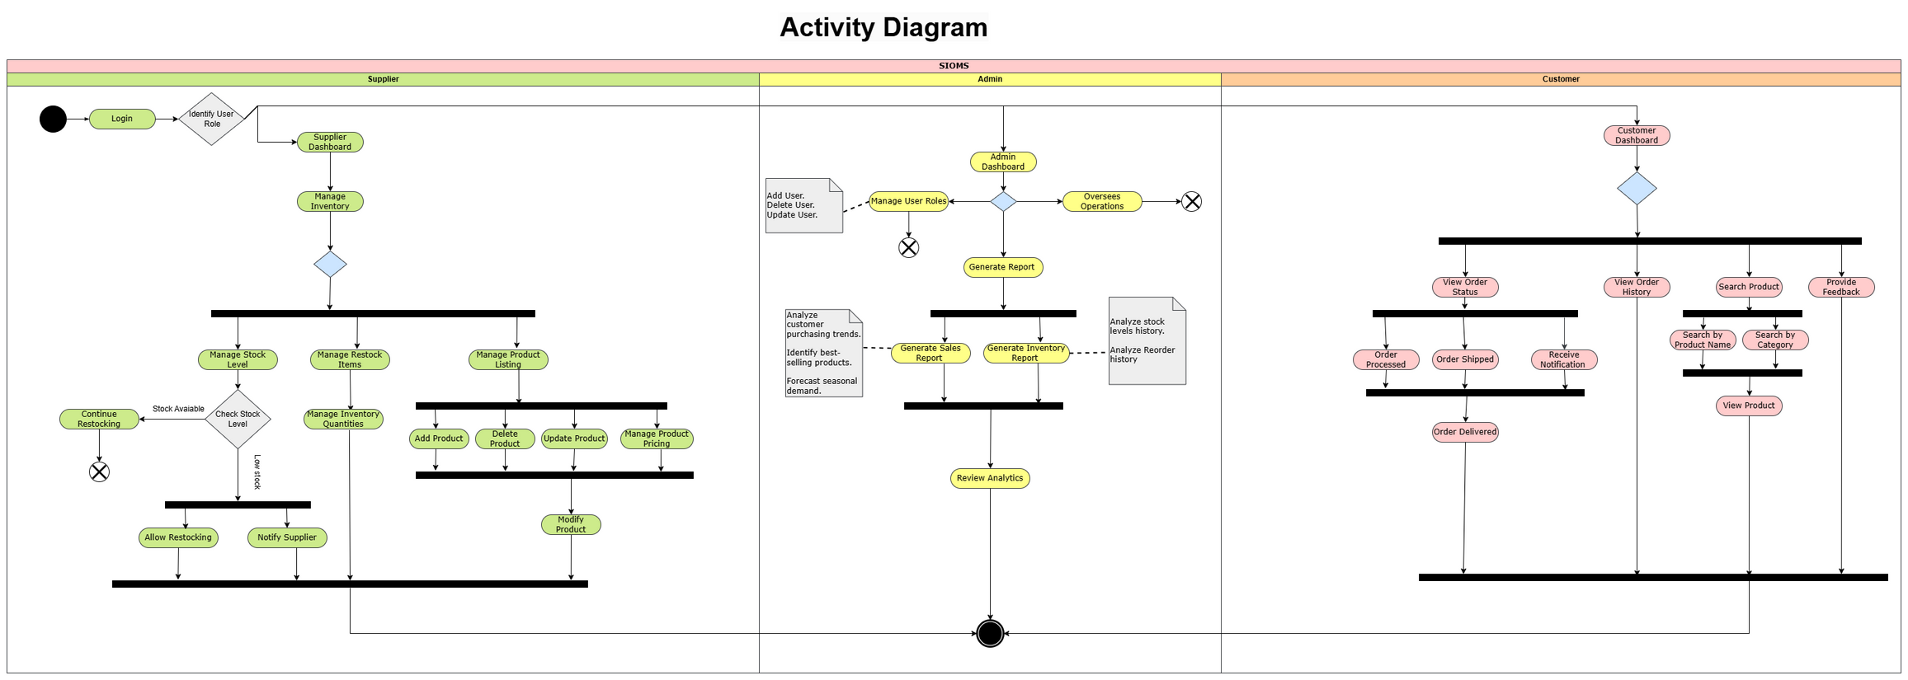
Activity Diagram

Slide 12
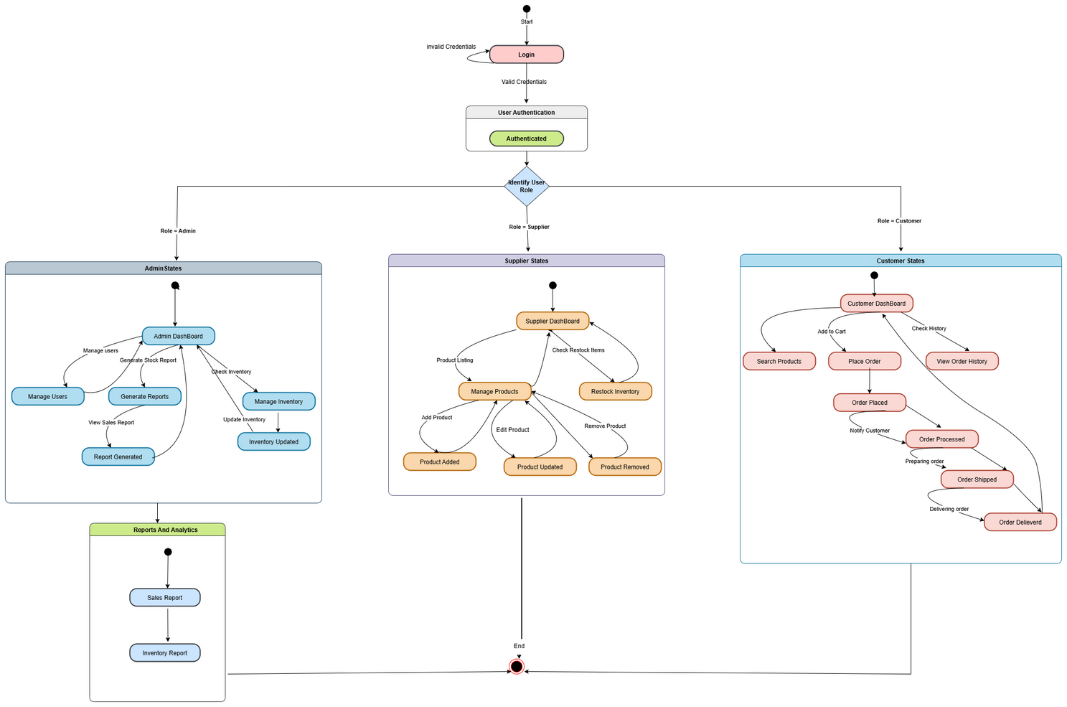
State Diagram

Slide 13
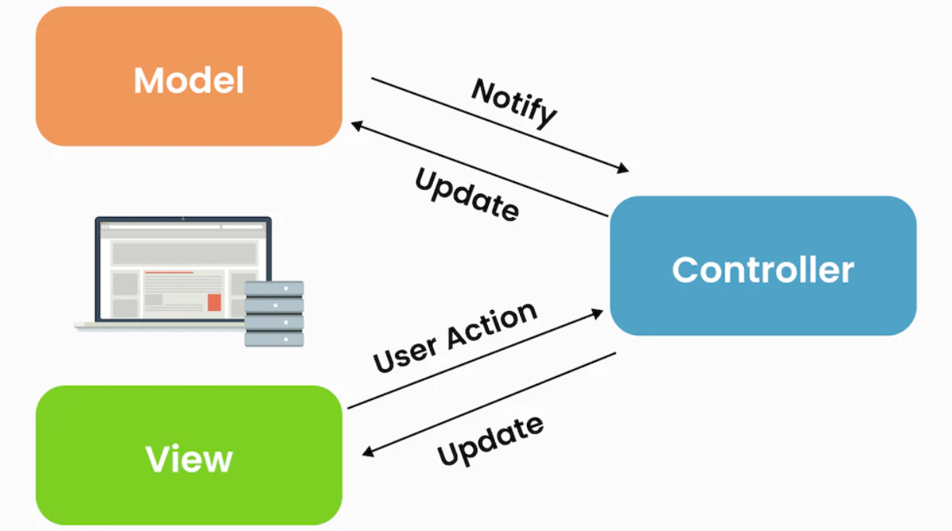
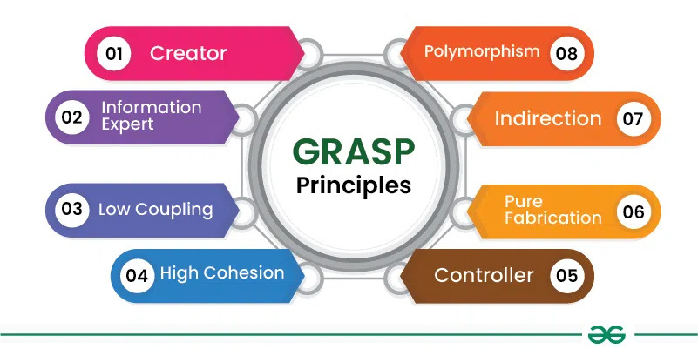
Topics
MVC
GRASP

Slide 14
MVC-Model View Controller
MVC stands for Model-View-Controller, a design pattern used in software development to separate an application into three main components:
Model: This represents the data or business logic of the application. It handles things like data storage, retrieval, and manipulation.
View: This is what the user sees and interacts with. It’s the UI (user interface) part, displaying the data from the Model to the user
Controller: This acts as the middleman between the Model and the View. It listens to user input (like clicks or keystrokes), processes it, and updates the Model and/or View accordingly.

Slide 15
In Short
MVC helps organize code, making it easier to manage, update, and scale by separating the logic, display, and user interaction parts of the application.

Slide 16
Example
MVC with a simple online shopping cart:
Model: This is the shopping cart's data. It stores items, their prices, and the total price.
View: This is the webpage that displays the cart. It shows the items, their prices, and the total amount to the user.
Controller: This handles user actions, like when a person adds an item to the cart. It updates the Model with the new item and then refreshes the View to show the updated cart.

Slide 17
Example in Action:
User adds a product to the cart (Controller).
The Model updates with the new product and calculates the total price.
The View is updated to show the new cart contents.
This separation makes it easy to change the appearance (View), business logic (Model), or user actions (Controller) without affecting the others.

Slide 18
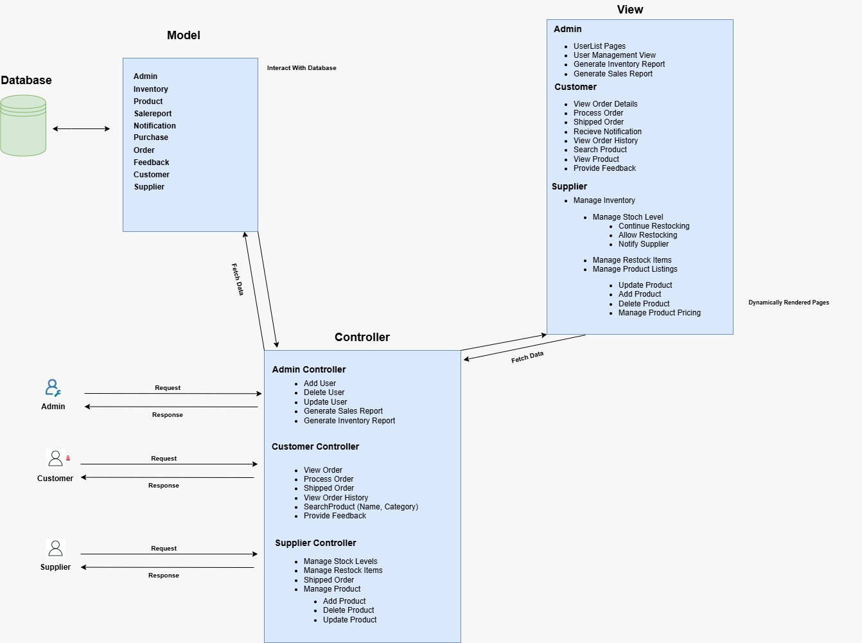
DIAGRAM

Slide 19
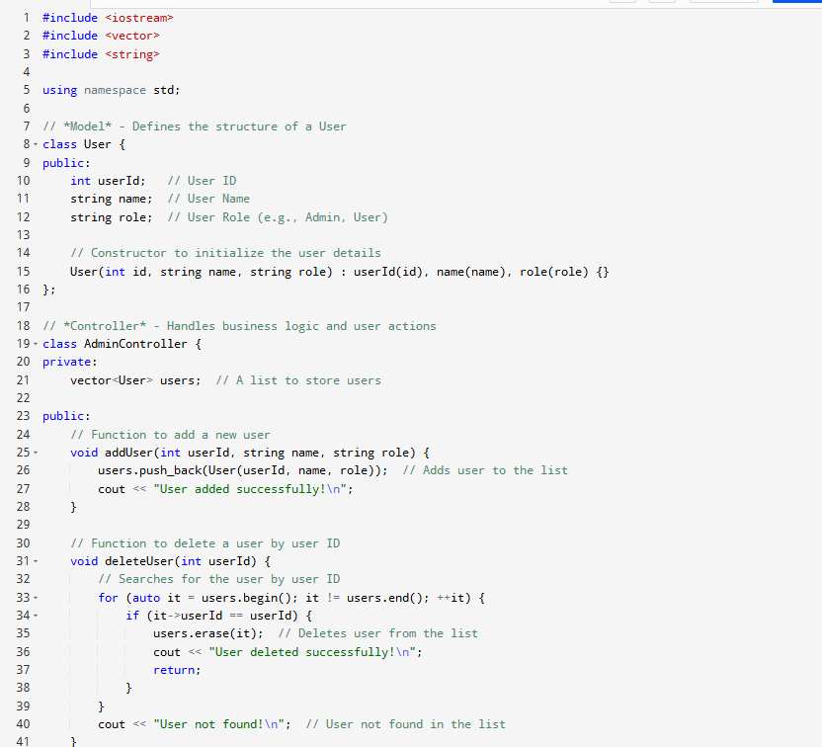
IMPLEMENTATION

Slide 20
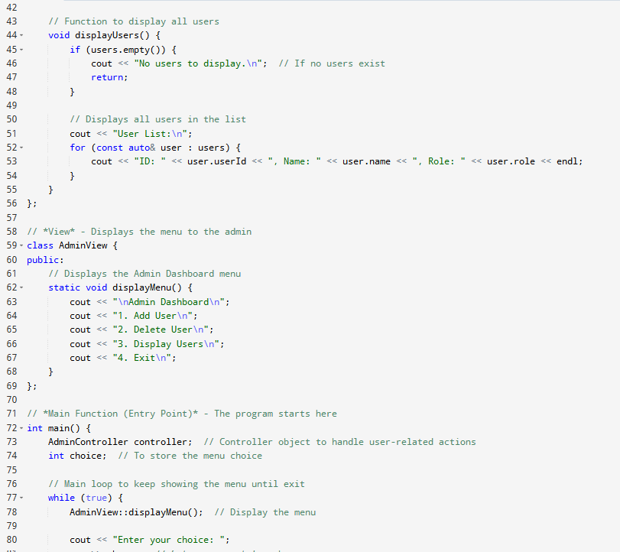
IMPLEMENTATION

Slide 21
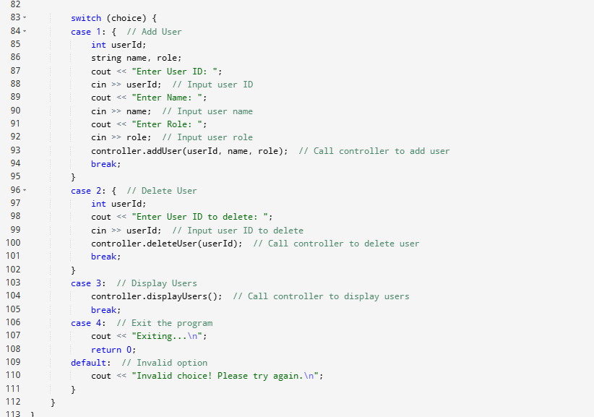
IMPLEMENTATION

Slide 22
EXPLANATION OF THE CODE
Model
The User class represents the data model, encapsulating attributes like userId, name, and role.
Controller
The AdminController class acts as the controller, handling user management operations:
addUser(int userId, string name, string role) adds a new user to the system.
deleteUser(int userId) removes a user based on their ID.
displayUsers() prints a list of all users.
View
The AdminView class provides the user interface with a static method displayMenu() to show options to the admin.
Main Function
Acts as the application entry point, allowing the admin to interact with the system via menu-driven options.

Slide 23
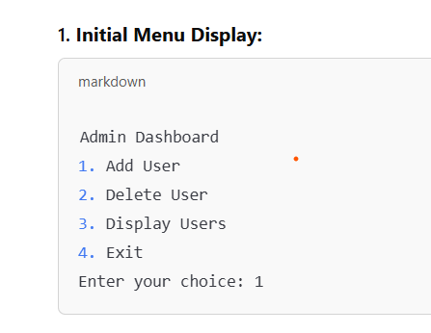
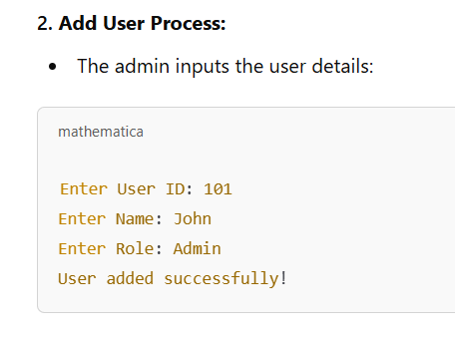
OUTPUT

Slide 24
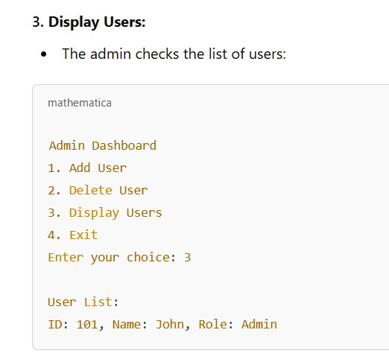
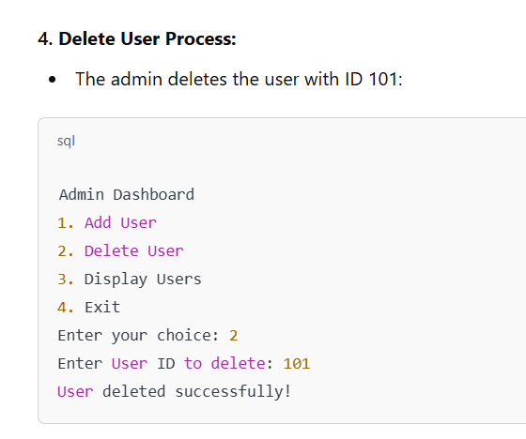
OUTPUT

Slide 25
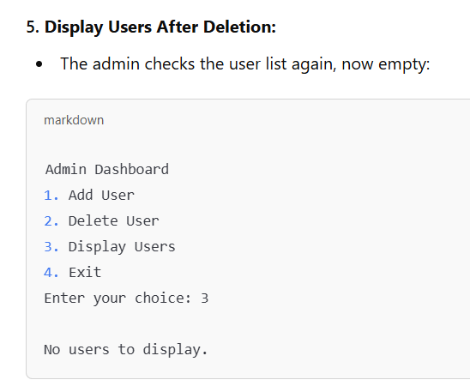
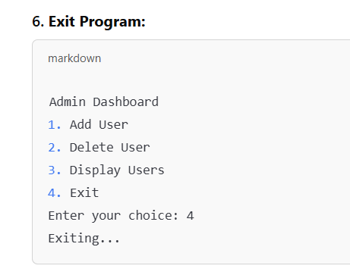
OUTPUT

Slide 26
GRASP (General Responsibility Assignment Software Patterns)
is a set of guidelines used to assign responsibilities to classes and objects in object-oriented design. Here are the key points:
Creator: Assign responsibility for creating instances of classes to the class that has the necessary information or is closely related to the new instance.
Controller: Assign the responsibility for handling system events (like user actions) to a controller class, which manages the flow of operations.
Information Expert: Assign the responsibility to the class that has the necessary data to fulfill a task, rather than passing it to another class.

Slide 27
In Short
GRASP helps assign responsibilities in object-oriented design:
Creator: The class that has the necessary information creates instances.
Controller: A class handles system events (like user actions).
Information Expert: The class with relevant data performs tasks.
These principles guide better, organized software design.

Slide 28
Example
Scenario: Online Bookstore
Creator:
The ShoppingCart class creates Order objects. This makes sense because the cart knows which items are being purchased, so it's responsible for creating the order when the customer is ready to checkout.
Controller:
The OrderController class handles actions like placing an order or cancelling an order. It receives events from the user, processes them, and interacts with the appropriate objects (like Order or Inventory) to carry out the operations.
Information Expert:
The Order class calculates the total price as it has all the necessary item details.

Slide 29
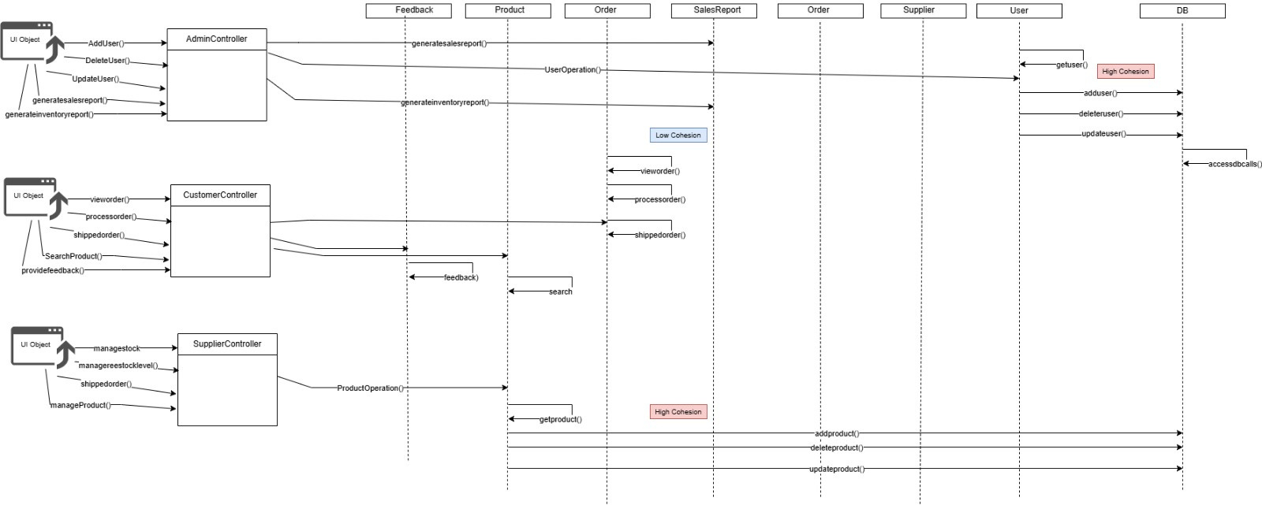
DIAGRAM

Slide 30
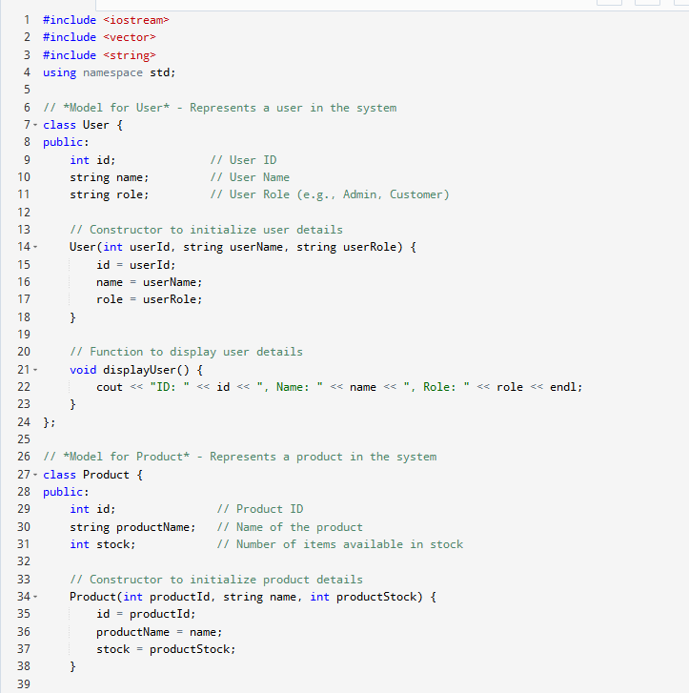
IMPLEMENTATION

Slide 31
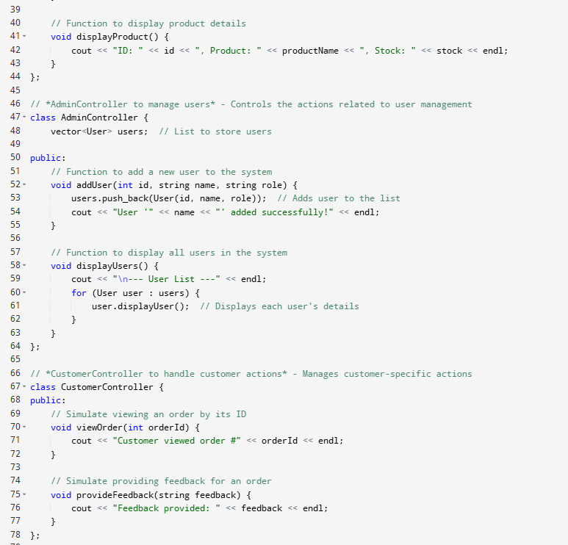
IMPLEMENTATION

Slide 32
User 'John Doe' added successfully!
User 'Jane Smith' added successfully!
--- User List ---
ID: 1, Name: John Doe, Role: Admin
ID: 2, Name: Jane Smith, Role: Customer
Customer viewed order #1001
Feedback provided: Excellent service, will order again!
OUTPUT

Slide 33
Explanation of Output:
Adding Users:
The Admin adds two users: "John Doe" (Admin) and "Jane Smith" (Customer). After each addition, a success message is printed.
Displaying Users:
The Admin displays all the users, showing their ID, Name, and Role.
Customer Actions:
The Customer views an order with the ID 1001 and provides feedback saying, "Excellent service, will order again!" These actions are simulated with appropriate messages.
This is a basic simulation of adding users and interacting with the system using the AdminController and CustomerController classes.

Slide 34
Links
https://drive.google.com/file/d/1oGuoalnd_uAe1a6h9XNFadI1dcN_qawc/view?usp=sharing

Slide 35
THANK YOU

